Slide 1
LOCALIZATION IN IMAGES USING NATURAL LANGUAGE QUERY
R.SUBHASHREE
VIRGINIA TECH

Slide 2
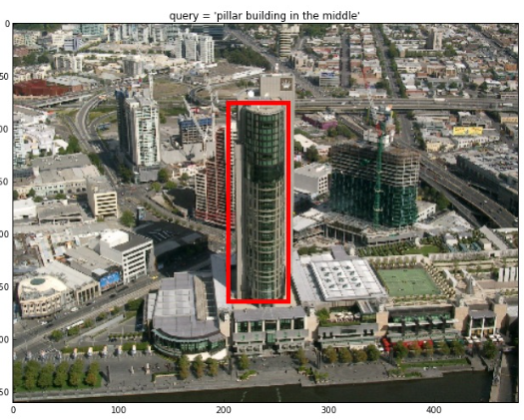
PROBLEM
To Localize an Object in an Image given a query
Input: Query + image
Output : Retrieve the corresponding Bounding box

Slide 3
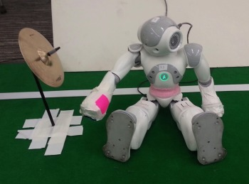

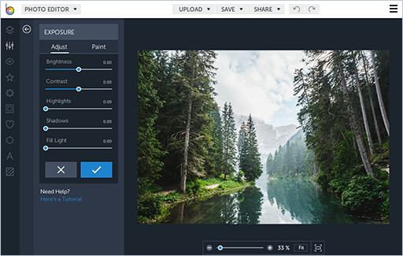
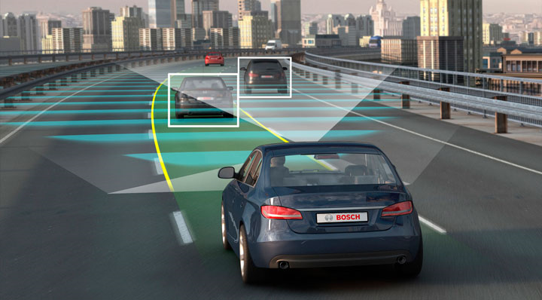
MOTIVATION
Query based recommender system
Query Directed Robot
Digital Editing based
On query
Query Based Self Driving
Car

Slide 4
DATASET
Refer It COCO Dataset
Refer It COCO dataset is used which was built on MSCOCO by additionally annotating with referring expressions. This dataset was collected in a two-player game.
The RefCOCO and RefCOCO+ datasets each contain 50,000 referred objects with 3 referring expressions on average. The dataset contains a total of 230k annotated descripions. The training and the test.
For our setting, I had used total of 99179 training examples with 80-20% split for training.

Slide 5
Data Preparation
The total number of training samples were 99179.
Manually generated the negative examples every query was set with a random bounding box annotation from the same image to which the query belonged to.
Every positive pair was assigned a label 0 and negative pair was assigned a label 1.

Slide 6
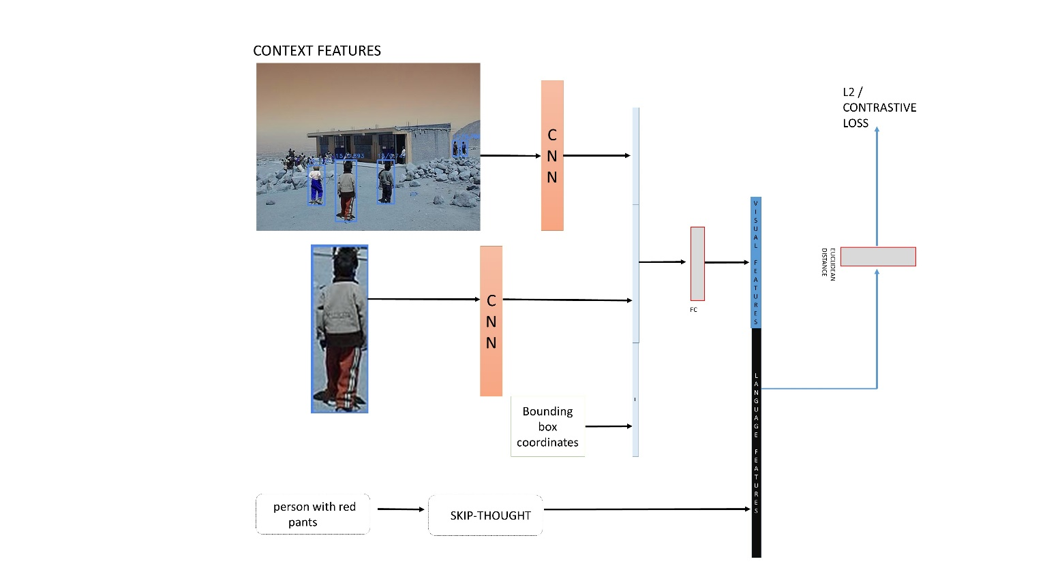
ARCHITECTURE

Slide 7
TEXT FEATURE GENERATION

Slide 8
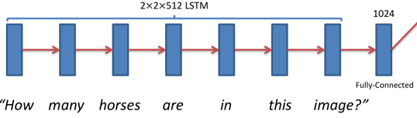
Text Encoding
GLOVE:
Glove is a count based model for encoding sentences. They
first construct a large matrix of co-occurrence information, i.e. for
each "word" (the rows), it counts how frequently we see this word
in some context in a large corpus. It uses the hidden representation
of the LSTM units to encode the sentence vector.

Slide 9
Word2Vec
Word2vec is a predictive model that learns a vector representation of the sentence by learning to predict the context/ target words. It is a feed forward network that is optimized using gradient descent.
Skip Thought Vector
The skip-thought model is trained to reconstruct the surrounding sentences to map sentences that share semantic and syntactic properties into similar vectors.

Slide 10
IMAGE FEATURE GENERATION

Slide 11

TRAINING DETAILS
Image Feature Extraction
30 Epochs
VGG – Pretrained for CNN, Dropout – 0.2, Momentum – 0.9, Learning rate – 0.1
The extracted image features were concatenated with the bounding box coordinates and the whole context features.
Losses:
1. Contrastive loss
Positive pair GT label : 0
Negative Pair label: 1
2. L2 loss
The Euclidean distance between image features and text features.

Slide 12
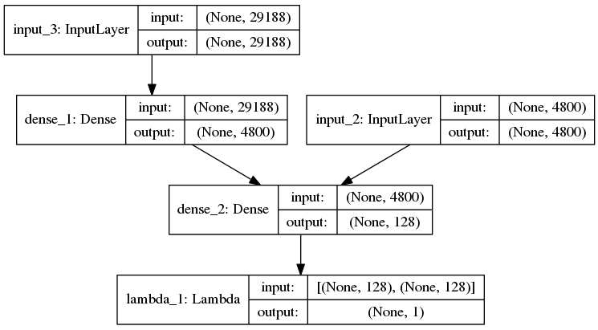
SIAMESE NETWORK

Slide 13
Other Embedding
Order Embedding
This embedding learns an ordered representation and is the state of the art in the image-caption retrieval problem.

Slide 14
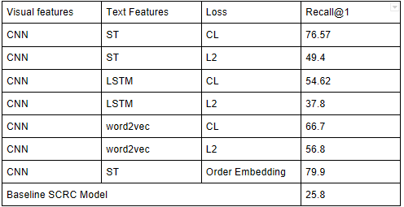
RESULTS
Quantitative
Metrics: Recall@1

Slide 15
Observations
As it can be seen from the results, in general contrastive loss performs better than the L2 loss.
The skip-thought vector outperformed the other two encodings and this is because the skip thought model uses an encoder decoder to learn representations
Glove and Word2vec performed almost similar
The context features include concatenated CNN features of the whole image. This information is especially useful when the query comprises of information of the spatial position of the person or the object.

Slide 16
TESTING
SSD
IMAGE
BOUNDING
BOXES
TRAINED
MODEL
Distance
QUERY
SKIP-THOUGHT

Slide 17
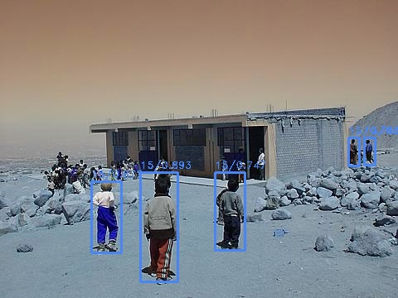
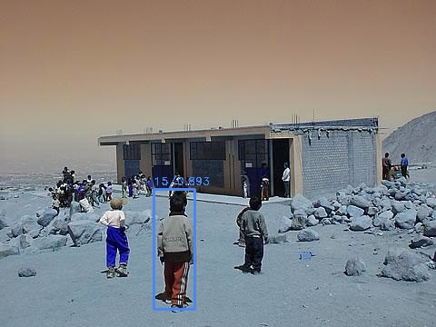
VISUALIZING RESULTS
Output of SSD
Least distance bounding box
Man with Red Pants

Slide 18
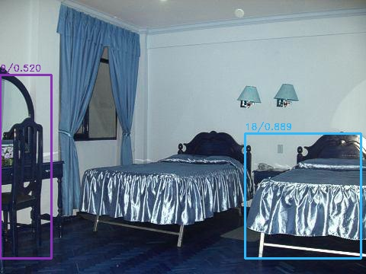
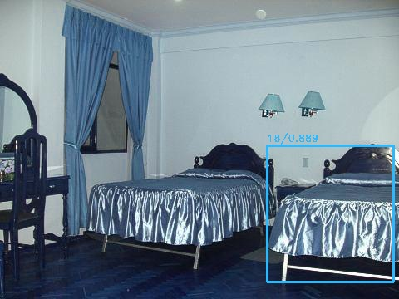
Output of SSD
Least distance bounding box
Bed on the Left

Slide 19
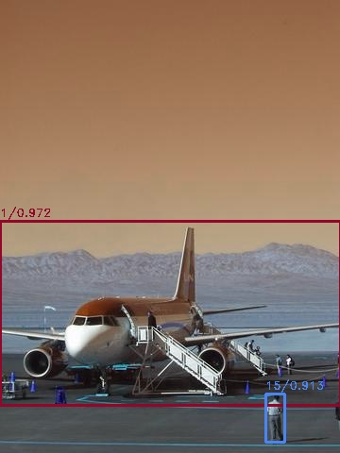

Output of SSD
Least distance bounding box
Man in front to the right

Slide 20
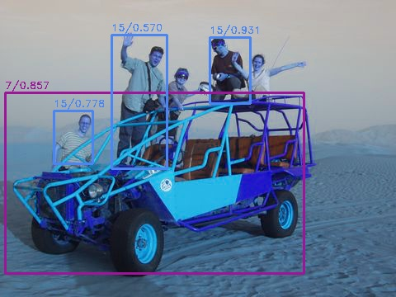
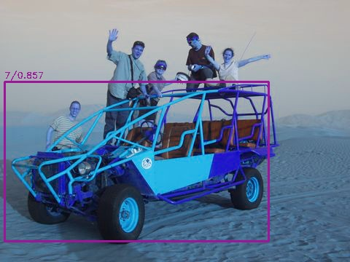
Output of SSD
Least distance bounding box
Vehicle in the bottom

Slide 21
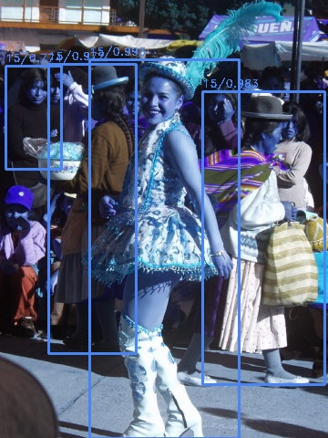
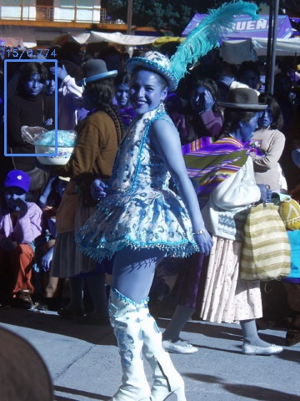
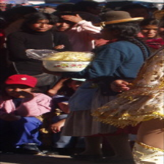
Failure – Unable to predict multiple objects
People to the Left
Predicted
Ground truth

Slide 22
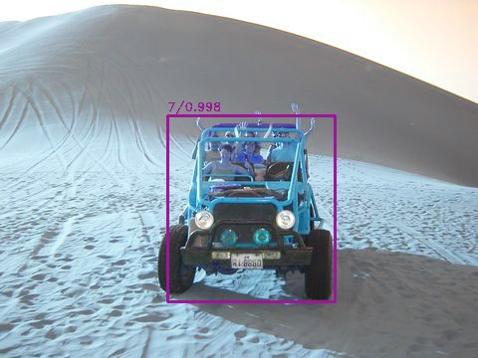
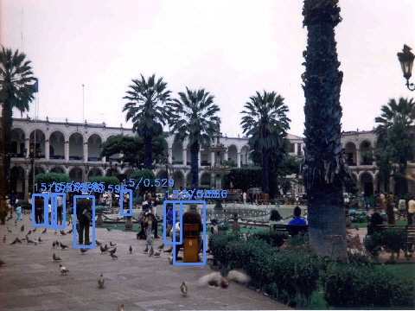
FAILURE CASES
SSD did not predict the classes
Mountain on top left
Palm Tree in Middle

Slide 23
Sand at the bottom

Slide 24
CONCLUSION AND FUTURE WORK
In general the system has learn spatial positioning of objects well in the image.
End to end training of CNN and Skip-thought/ word2vec. This way the skip-thought vector would encode features unique to the individual bounding box, and the CNN would generate image features in accordance with the query.
When the model is trained end to end, The visual features for the embedding can be encoded in an unsupervised way using an autoencoder
Since, the SSD could not identify all objects as it is pretrained separately, the SSD bounding box generation should be included in the end to end architecture instead of generating them offline.

Slide 25
REFERENCES
[6] Benjamin Klein, Guy Lev, Gil Sadeh, and Lior Wolf. 2014. Fisher vectors derived
from hybrid gaussian-laplacian mixture models for image annotation. arXiv
preprint arXiv:1411.7399 (2014).
[7] Junhua Mao, Jonathan Huang, Alexander Toshev, Oana Camburu, Alan L Yuille,
and Kevin Murphy. 2016. Generation and comprehension of unambiguous object
descriptions. In Proceedings of the IEEE conference on computer vision and pattern
recognition. 11–20.
[8] Brian McFee and Gert Lanckriet. 2009. Partial order embedding with multiple
kernels. In Proceedings of the 26th Annual International Conference on Machine
Learning. ACM, 721–728.
[9] Varun K Nagaraja, Vlad I Morariu, and Larry S Davis. 2016. Modeling context
between objects for referring expression understanding. In European Conference
on Computer Vision. Springer, 792–807.
[10] Fudong Nian, Teng Li, Yan Wang, Xinyu Wu, Bingbing Ni, and Changsheng Xu.
2017. Learning explicit video attributes from mid-level representation for video
captioning. Computer Vision and Image Understanding 163 (2017), 126–138.
[11] Mayu Otani, Yuta Nakashima, Esa Rahtu, Janne Heikkilä, and Naokazu Yokoya.
2016. Learning joint representations of videos and sentences with web image
search. In European Conference on Computer Vision. Springer, 651–667.
[1] Luca Bertinetto, Jack Valmadre, Joao F Henriques, Andrea Vedaldi, and Philip HSTorr. 2016. Fully-convolutional siamese networks for object tracking. In European Conference on Computer Vision. Springer, 850–865.
[2] Andrea Frome, Greg S Corrado, Jon Shlens, Samy Bengio, Jeff Dean, Tomas Mikolov, et al. 2013. Devise: A deep visual-semantic embedding model. In Advances in neural information processing systems. 2121–2129.
[3] Ronghang Hu, Marcus Rohrbach, Jacob Andreas, Trevor Darrell, and Kate Saenko. 2016. Modeling relationships in referential expressions with compositional modular networks. arXiv preprint arXiv:1611.09978 (2016).
[4] Ronghang Hu, Huazhe Xu, Marcus Rohrbach, Jiashi Feng, Kate Saenko, and Trevor Darrell. 2016. Natural language object retrieval. In Proceedings of the IEEE Conference on Computer Vision and Pattern Recognition. 4555–4564.
[5] Ryan Kiros, Ruslan Salakhutdinov, and Richard S Zemel. 2014. Unifying visualsemantic embeddings with multimodal neural language models. arXiv preprint

Slide 26
THANK YOU ☺
QUESTIONS??

